Slide 1
Team 4: 311 Service Requests
Weichen Jiang
Kyran Chen
Cheng-Ping Lin

Slide 2
Extension Project
Overview
As we discovered the relationship between social vulnerability and the amount of service requests, we want to explore what types of services those areas are in demand and what resources may be lacking for certain locations
Questions
Have the types of requests changed over the years for areas with high social vulnerability people?
How are they reporting these requests?
Do areas with more older adults respond well to the new City Worker App?

Slide 3
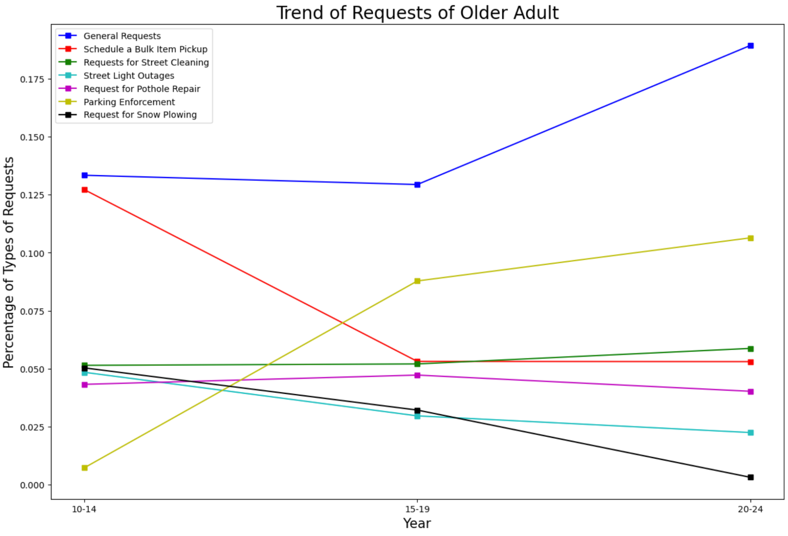
Extension Analysis
Have the types of requests reported by areas with high socially vulnerable population changed over the years?

Slide 4
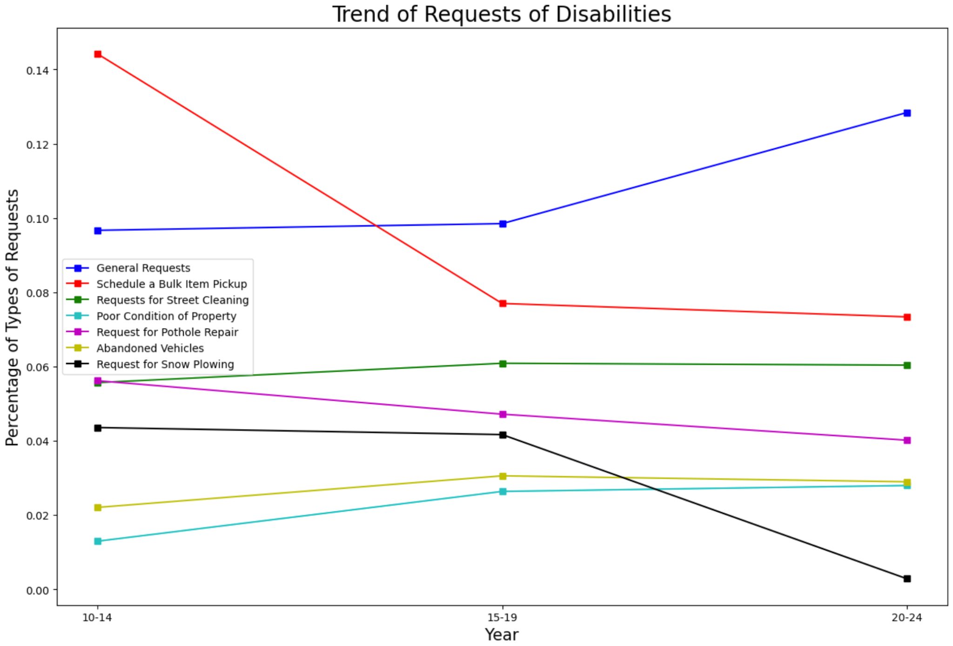
Extension Analysis
“Poor Conditions of Property”
“Abandoned Vehicles”

Slide 5
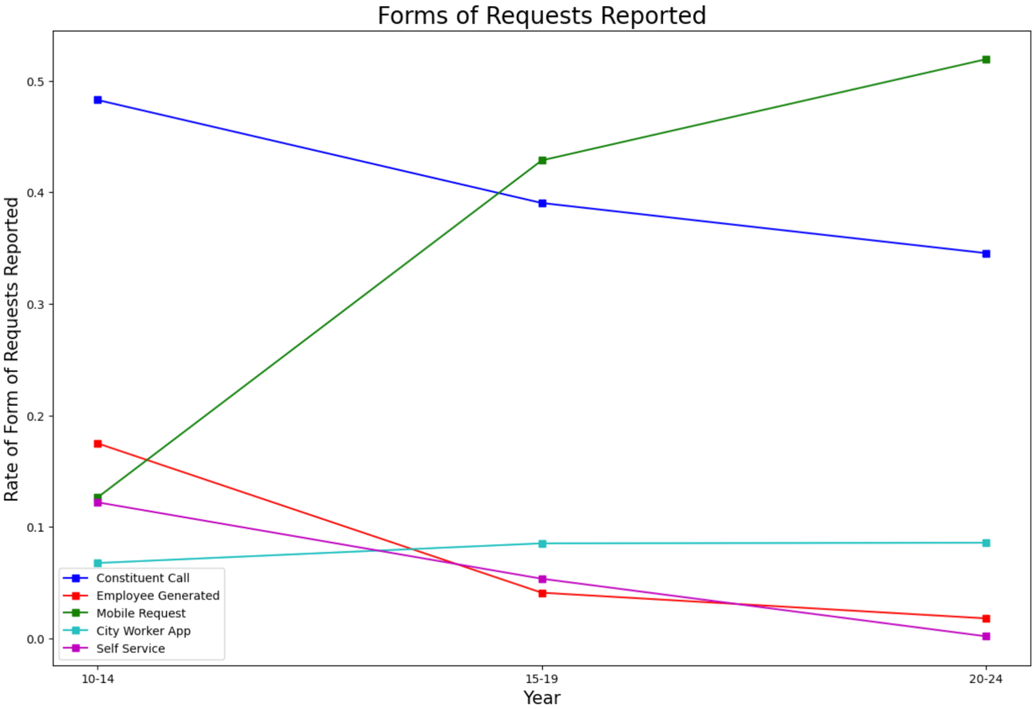
Extension Analysis
As City Worker app was published in 2009, how has the source of 311 requests changed?
Specifically, how do older adults respond to that?

Slide 6
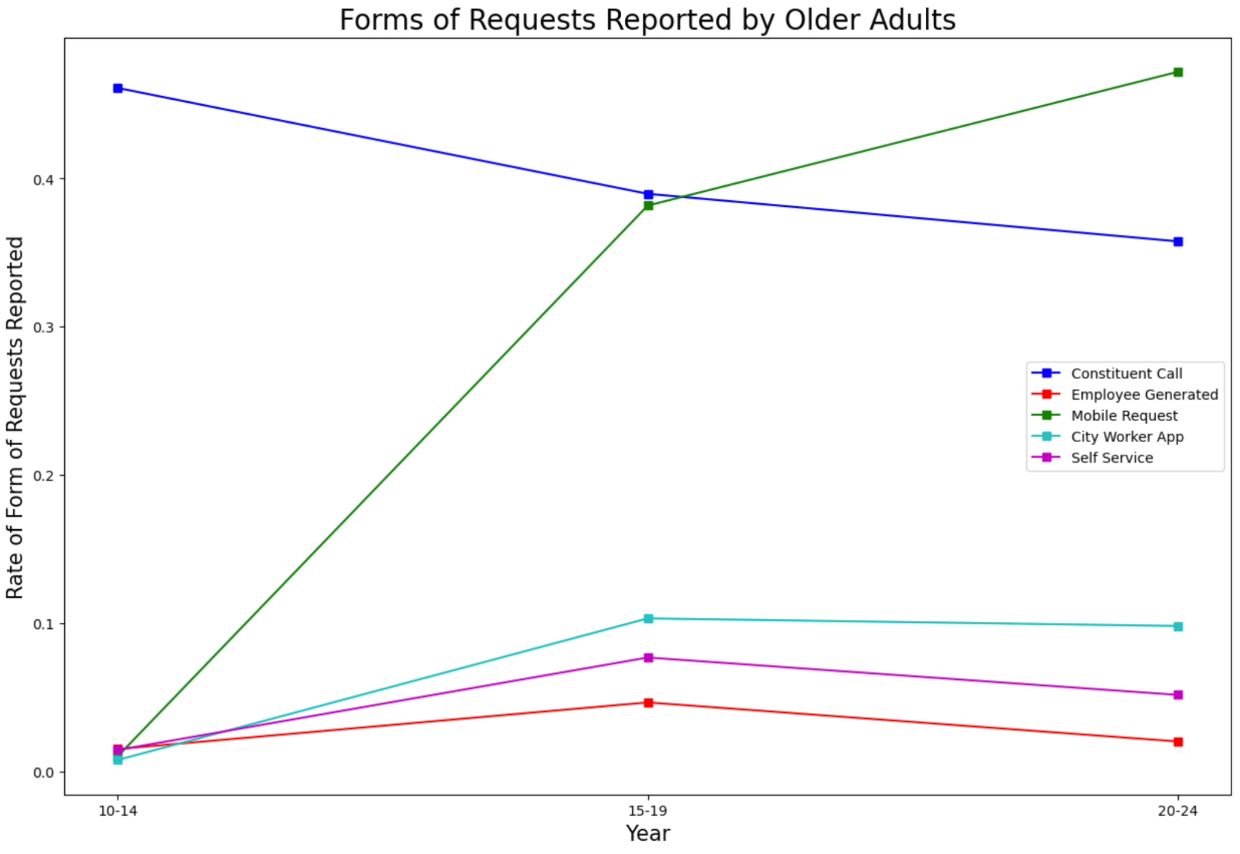
Extension Analysis
Areas with higher older adults adapts to the new app slower in the beginning
In the span 2015-2019, the use rate is up to average

Slide 8
Base Analysis
Establish social vulnerability status of the location for each 311 requests
What service requests are most common for the city overall and by census tract
What is the pattern of demographics and service requests: looking at census block groups and social vulnerability index
Is the rate of closure for different types of service requests the same across different census tract?

